Slide 1
Where Does the Prompt Go?
Probing prompt adherence in Stable Diffusion 1.5: guidance, denoising steps, cross-attention and a simple fix
• 1008 images: 28 controlled prompts x 3 CFG scales x 2 step counts x 6 seeds, all paired
• 504 cross-attention extractions; 504 images in a matched intervention test
• Measured adherence rises only weakly with guidance (+0.07 from CFG 2 to 7.5, CI [-0.01, +0.15]); similarity and diversity change clearly
• Attention re-weighting (2x object/colour tokens): overall success +0.02 [-0.04, +0.09], so H4 is not supported
Where Does the Prompt Go? | Stable Diffusion 1.5 prompt-adherence study
1
Notes:
A diffusion model can draw a convincing picture and still ignore part of the prompt: wrong colours, a missing object, the wrong count. I asked how guidance scale and denoising steps change that for five kinds of constraint, whether cross-attention shows the failure, and whether a cheap inference-time change helps. I will show the measurements, including what stayed inconclusive.

Slide 2
Hypotheses, written before the main run
• H1 CFG 2 -> 7.5 improves every constraint type; 7.5 -> 15 adds little for binding, counting and multi-constraint prompts
• H2 20 vs 40 denoising steps matters much less than CFG, with no CFG x steps interaction
• H3 (exploratory) Higher CFG localises object attention; colour tokens overlap the wrong object in binding failures; attention alone is a weak predictor (AUC < 0.75)
• H4 (added before the intervention run) Boosting object and colour token attention by 2x at CFG 7.5 raises success by >= 0.05 without hurting CLIP score by more than 0.5
• Refutation criteria and the analysis plan were fixed in report/protocol.md; revisions are logged there
Where Does the Prompt Go? | Stable Diffusion 1.5 prompt-adherence study
2
Notes:
CFG pushes the noise prediction away from the unconditional one: eps = eps_uncond + w (eps_cond - eps_uncond). I predicted a rise up to the default and a plateau beyond it, a small effect of steps, and more localised object attention with guidance. H4 was added after the main results, before any intervention image was generated: scale the attention weight of the object and colour words, a gradient-free cousin of Prompt-to-Prompt re-weighting. For each prediction I wrote down what would contradict it.

Slide 3
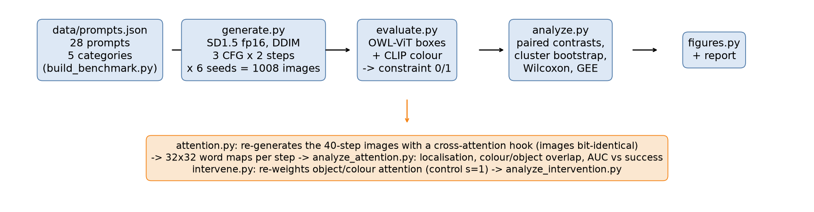
Method
• Same seed gives the same noise in every CFG x steps cell, so every contrast is paired by prompt and seed
• Statistics treat the prompt as the unit: cluster bootstrap CIs, Wilcoxon on prompt-level differences, Holm correction
• The attention hook leaves images bit-identical (max pixel difference 0), so the maps describe the images that were scored
Where Does the Prompt Go? | Stable Diffusion 1.5 prompt-adherence study
3
Notes:
Prompts come from templates with structured constraints, so evaluation never parses text. Generation and evaluation are separate programs. The attention hook computes the output with the default fused kernel and only recomputes the probabilities for recording, which is why the images are bit-identical. Because seeds repeat across all cells, I compare the same prompt and seed under different settings, and I resample prompts, not images, for uncertainty.

Slide 4
Benchmark and metrics
• 28 prompts: presence 4, binding 6, counting 6, spatial 6, multi 6; colour and left/right swapped variants
• Complexity = number of constraints (2 to 5)
• OWL-ViT boxes -> presence, count, left/right; CLIP colour on the object's box -> binding
• Primary outcome: all constraints satisfied (counting prompts: count only)
• Secondary: CLIP image-text score, seed diversity
• Labels: one non-independent annotator (Claude), two passes; spatial has few positives
Evaluator vs 40 hand-labelled images
constraint | accuracy | positives
presence | 0.93 | 46
colour binding | 0.83 | 18
count | 1.00 | 5
spatial | 0.90 | 2
Where Does the Prompt Go? | Stable Diffusion 1.5 prompt-adherence study
4
Notes:
Binding is scored by classifying the colour of the box of each object, so detecting something red and something blue is not enough: the colour must sit on the right object. The validation labels were written by me with Claude's help from the images, then re-checked in a second pass; two ambiguous constraints were set aside. Please spot-check them. Yellow-green apples are read as green by CLIP, so counting prompts are judged on the count alone. Spatial accuracy rests on very few positive examples.

Slide 5
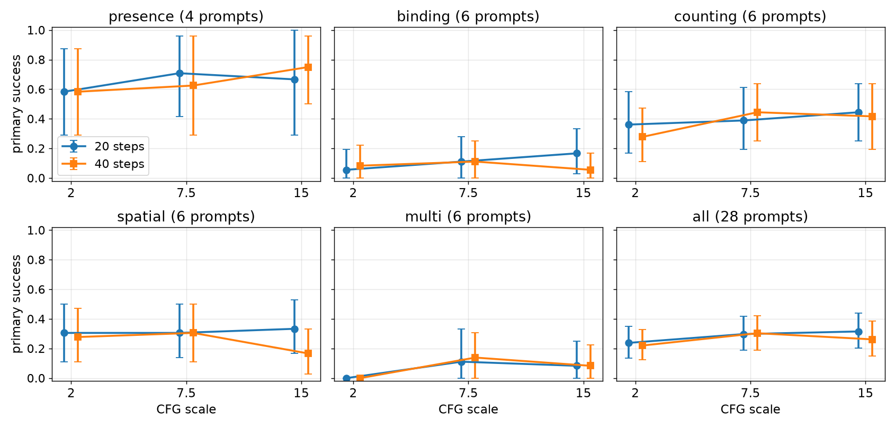
Adherence vs CFG and denoising steps
CFG 7.5 vs 2: +0.07 [-0.01, +0.15], Holm p = 0.174; CFG 15 vs 7.5: -0.01; 40 vs 20 steps: -0.02 [-0.07, +0.02]; interaction p = 0.37
Where Does the Prompt Go? | Stable Diffusion 1.5 prompt-adherence study
5
Notes:
Overall success is low, 0.22 to 0.32 depending on the cell. Going from CFG 2 to 7.5 raises overall success by +0.07, interval [-0.01, +0.15]: positive but not significant. From 7.5 to 15 there is no gain overall, and spatial prompts fall at CFG 15 with 40 steps. Steps change little and there is no CFG by steps interaction. With four to six prompts per category the per-category tests have little power, so I report intervals and do not claim category effects. CLIP similarity rises by +1.88 and diversity falls from 0.21 to 0.14: guidance clearly changes the images even if measured adherence barely moves.

Slide 6
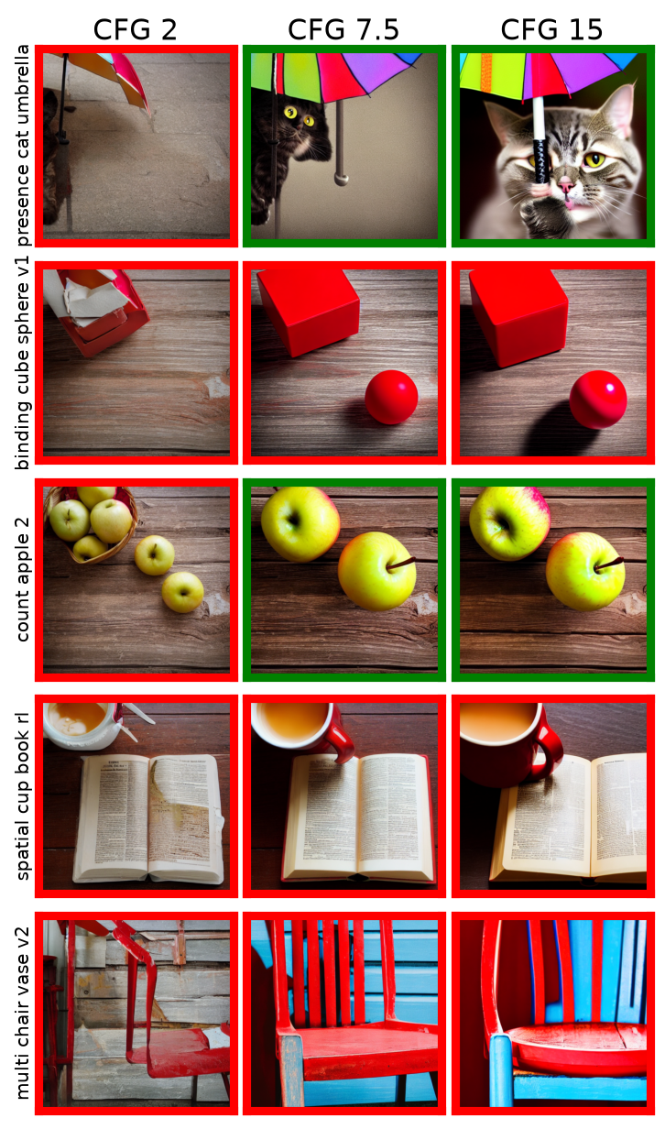
What success and failure look like
• Rule: per category, the prompt closest to the median success rate; seed 0; 40 steps (all six settings: contact_sheet.png); green = success, red = failure
• CFG 2: washed-out images, objects often missing
• CFG 7.5-15: objects appear but colours leak (cube and sphere both red) or an object is dropped (chair, no vase)
• Spatial: the requested side is not respected at any setting
Where Does the Prompt Go? | Stable Diffusion 1.5 prompt-adherence study
6
Notes:
One prompt per category, chosen by a fixed rule so I do not show only successes, with seed 0 in all six settings. At CFG 2 images are low contrast and often miss the objects. At higher CFG the objects appear but binding fails: in the cube and sphere row both objects are red, and in the chair and vase row only a chair is drawn. That is the classic attribute-binding and neglect failure.

Slide 7
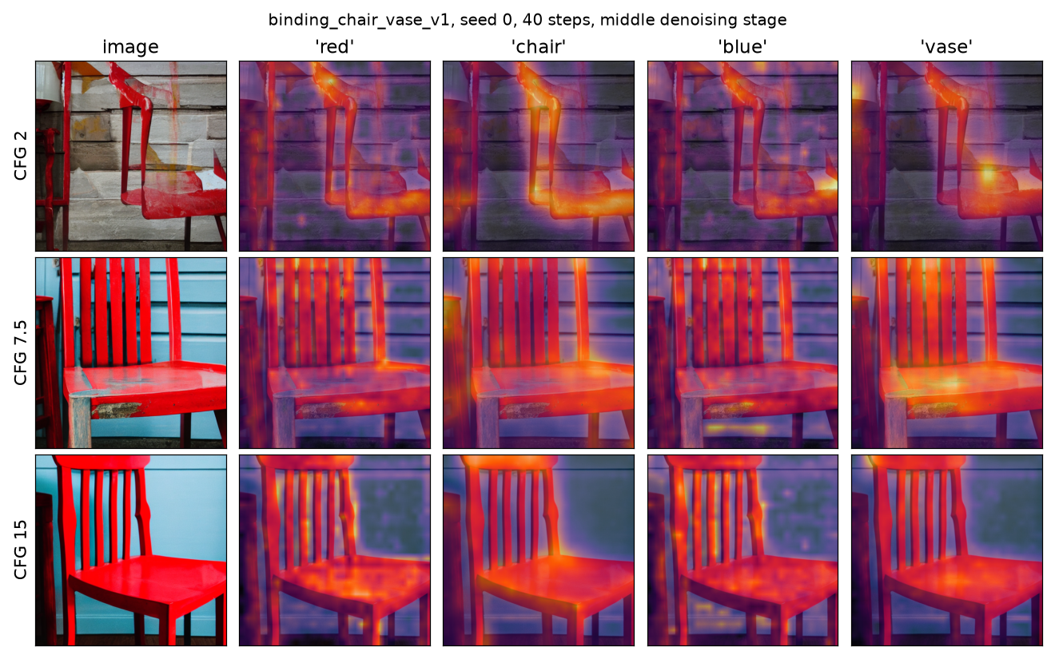
Cross-attention of the prompt words
• Rows: CFG 2, 7.5, 15 (same prompt and seed); columns: the words red, chair, blue, vase
• All four words light up the same chair: no separate region for the vase or the blue
• Early and late stages: attention_maps_by_cfg.png (full figure)
• One example chosen by rule; quantitative summary next
Where Does the Prompt Go? | Stable Diffusion 1.5 prompt-adherence study
7
Notes:
Each row is a CFG value for the same prompt and seed; the columns are the attention maps of four words in the middle of denoising. The prompt was chosen by a rule, the binding prompt closest to 50 percent success. All four word maps land on the same chair: the vase and blue tokens never get a region of their own. That is what a dropped object looks like inside the model. This is one example; the next slide is the quantitative summary.

Slide 8
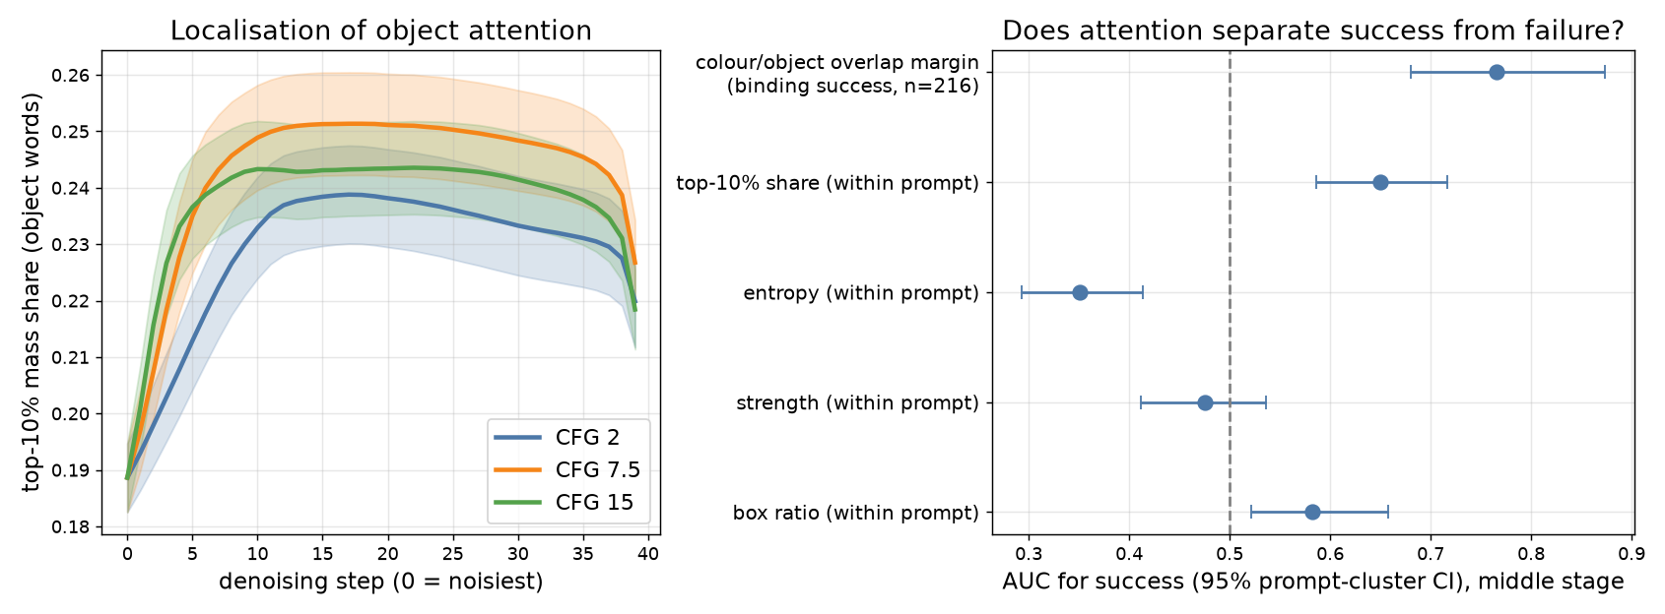
Does attention explain the outcome?
Localisation rises from CFG 2 to 7.5 (+0.0139 mid-stage, CI [+0.0081, +0.0196]) and does not rise at 15; colour/object overlap margin: AUC 0.77 [0.68, 0.87] for binding success; attention-only classifier AUC 0.71 vs 0.74 for category + CFG alone. Exploratory, correlational.
Where Does the Prompt Go? | Stable Diffusion 1.5 prompt-adherence study
8
Notes:
Left: object-word maps become more concentrated from CFG 2 to 7.5 and do not improve at 15, parallel to the plateau in adherence. Right: the margin between how much a colour word overlaps its own object versus the other object separates binding successes from failures, with AUC 0.77. For overall success, lower entropy goes with success, so its AUC is below 0.5. A classifier built only from attention summaries has AUC 0.71, no better than knowing category and CFG, 0.74. These are exploratory associations, not causal evidence.

Slide 9
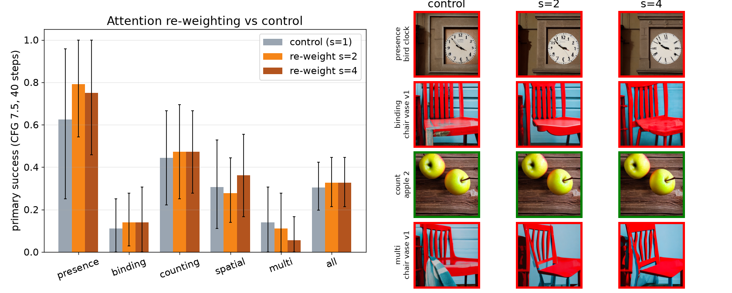
Simple intervention: attention re-weighting
• Primary: s = 2 vs control +0.02 [-0.04, +0.09], Holm p = 0.757; s = 4 +0.02 [-0.05, +0.10]. Pre-registered threshold was +0.05 with CI above 0.
• Exploratory: object presence +0.09 [+0.01, +0.17]; binding +0.02 [-0.07, +0.11]; CLIP +0.07. Matched prompts, seeds, CFG 7.5, 40 steps; control reproduces baseline.
Where Does the Prompt Go? | Stable Diffusion 1.5 prompt-adherence study
9
Notes:
Hypothesis four was written down before any intervention image existed: multiply the attention weight of the object and colour words by 2 in the conditional branch, a gradient-free relative of Prompt-to-Prompt re-weighting. The control uses exactly the same code with a factor of 1 and reproduces the baseline images, so any difference comes from the factor and not from the code path. The pre-registered prediction was a gain of at least 0.05 in overall success with an interval above zero. We got +0.02, interval [-0.04, +0.09], so the hypothesis is not supported, and a factor of 4 does not change that. Binding and multi-constraint prompts did not improve. One secondary outcome, whether all requested objects are present, rose by +0.09, interval [+0.01, +0.17]; that is one of six outcomes I looked at without correction, so I present it as a lead for follow-up and not as a finding. CLIP score did not change.

Slide 10
Takeaways and limitations
What we can say
Limitations
• CFG 2 -> 7.5: clear gains in CLIP similarity (+1.88) and localisation, less diversity; adherence +0.07 (not significant)
• More steps or CFG 15: no measurable benefit here
• Binding fails by colour leakage and dropped objects; colour/object attention overlap flags it (exploratory)
• Re-weighting object/colour attention did not raise overall success (+0.02 [-0.04, +0.09]); only object presence moved (exploratory)
• 4-6 prompts per category; different objects per category
• Low base rates; evaluator not perfect; one annotator; spatial barely validated
• One model, scheduler, resolution; coarse CFG grid
• Attention: conditional branch, layer/head average, correlational
• Intervention tested at one CFG, one step count and one token rule
Where Does the Prompt Go? | Stable Diffusion 1.5 prompt-adherence study
10
Notes:
The honest summary: guidance clearly changes similarity, diversity and attention localisation, and has a small unconfirmed effect on measured adherence. The intervention did not help overall success, so the hypothesis about re-weighting is not supported; only object presence moved, as an exploratory lead. The study can describe associations and rule out large step effects in this range, but not confirm small per-category effects. The evaluator is imperfect, with one non-independent annotator. Natural next steps are a larger benchmark, more CFG levels, and testing re-weighting variants that target the colour/object overlap directly.

